Slide 1

If-Else, Loops
!false; it's funny because it's true!
Ashish Pimple
Prathmesh Palande
Pratik Loya
TOC EUS Automation
May 27, 2019

Slide 2


Conditions
2B || !2B
Programming in any language is always about answering the basic True and False question.
Source code is organized into logical blocks. In Python defined by indentation.
The most basic and common type of flow control is the IF statement.
Lines of Python code be grouped together in blocks:
Blocks begin when indentation increases
Blocks can contain other blocks
Blocks end when indentation decreases to zero or to a containing
block's indentation

Slide 3

Comparison & Boolean
Comparison operators:
== equal to
!= not equal to
< less than
> greater than
<= less than or equal
>= greater than or equal
= is the assignment operator, == is a comparison operator
Python syntax: if keyword, condition, colon, indented block of code starting from next line.
Boolean operators: and, or, not
What are the results of below statements:
True and False
False and False
True or False
False or False
Mixing Boolean operators with comparison operators in Python:
How to fix the above code to get the famous phrase printed out?

Slide 4
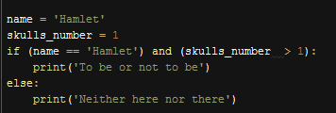
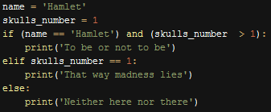
Chaining Conditions: if moustache == true Grandpa else Grandma
Alternative execution offers two paths to follow based on the condition test result:
Chained conditions: elif
Python syntax: elif keyword, condition, colon, indented block of code starting from next line.

Slide 5

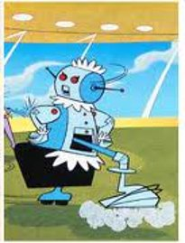

while (hoovering == true) i_am_busy
The while statement looks similar to an if statement. Initially starts with condition check. At the end of an if clause, the program execution continues after the if statement. But at the end of a while clause, the program execution loops back to the start of the while statement:
Endless(infinite) while loop fix:
How many times "I am busy" will be printed?
Python syntax: while keyword, condition, colon, indented block of code starting from next line.

Slide 6
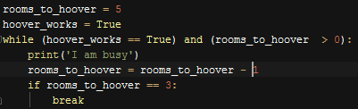
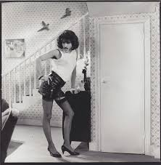
I want to break free!
The break statement is a shortcut to jump out of while loops immediately.
How many times "I am busy" will be printed?
Python syntax is simply break keyword placed inside the loop. Once reached, loop will end.

Slide 7
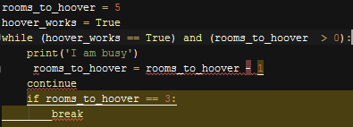
continue hoovering until it's done
The continue statement is a shortcut to jump back to the start of the loop and reevaluates the loop’s condition. Both break and continue statements are used inside loops.
How many times "I am busy" will be printed?
Python syntax is simply continue keyword placed inside the loop.

Slide 8

for all_rooms in range of my_house
The for loop is used to run block of code only a certain number of times.
How many times "I am busy" will be printed?
Python syntax: for keyword, a variable name, in keyword, call to the range() method with up to three integers passed to it, colon, indented block of code starting from next line.
*range(x, [y, z]) returns a list, or similar valued data: Used to generate data for the loop

Slide 9

What is the room range of my_house?
The range() function can be used with up to 3 arguments separated by the coma.
What will be printed out?
If range(y) is used with one argument, it will start with 0 up to the value of the y argument not including it, with default increment 1.
If range(x, y) is used with 2 arguments, it will start with the value of first argument(x) up to the value of the second argument(y) not including it, with default increment 1.
If range(x, y, z) is used with 3 arguments, it will start with the value of first argument(x) up to the value of the second argument(y) not including it, with the increment set to third argument(z).

